Slide 1
ASP.NET MVC: Patterns & Principals
Todd Snyder
Development Team Lead
Infragistics Experience Design Group

Slide 2
ASP.NET MVC – Patterns & Principals
Concepts and Patterns
MVC/MVP Frameworks
Best Practices

Slide 3
ASP.NET MVC – Patterns & Principals
Concepts and Patterns

Slide 4
What is a pattern?
BaseSalesTax
NJSalesTax
NYSalesTax
PASalesTax
A reusable solution to a commonly occurring problem within a specific context. They are blue prints for solving a problem and not a finished solution. Depending on the platform and environment you are working with the implementation of a pattern may be different.

Slide 5
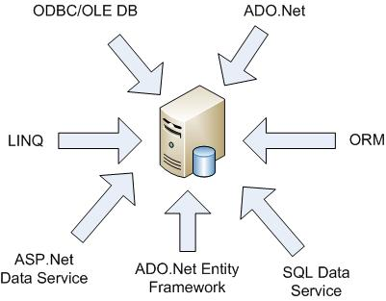
Design Principals - Drive Design
Separation of Concerns
Loosely Coupled/High Cohesion
Flexibility/Adaptable
Code Reuse
Testability
How many data access technologies do we need?

Slide 6
MVC Pattern – Separating Concerns
Behaviors (Business Rules) and Data
Real world domain classes (Customers, Orders, Products)
Model
Handles Input Requests
Interacts with Model
Determines which view to render
Controller
View
Renders the contents of a model
Maintains consistency between itself & the model (Stateful)

Slide 7
One Pattern – Many Implementations
Supervising Controller
Passive View
Model
Model
Presenter (Controller)
Presenter (Controller)
View
View
Presenter/View Model
Presenter Model
Model
View
Presenter (Controller)

Slide 8
MVC (Controller) vs MVP (Presenter)
MVC Pattern
Controller Drives Flow (Front Controller)
Based on UI Action (Behaviors)
Can Determine which view to display
View usually has direct access to the model
MVP Pattern
View Drives Flow & Delegates to the presenter
View & Model more loosely coupled
Traditionally Easier to unit test (Using Interface)
View to presenter usually map one to one

Slide 9
Dependency Injection (IOC)
Concrete Dependency
Product
Controller
Check Out
Service
Interface (Abstraction) Dependency
Product
Controller
IService
Check Out
Service
Injected Dependency
Product
Controller
IService
Assembler
Check Out
Service

Slide 10
ASP.NET MVC – Patterns & Principals
MVC/MVP Frameworks

Slide 11
Frameworks
Windows
Composite Application Block (CAB)
Smart Client Software Factory (SCSF)
Prism (CAB for WPF)
Web
Web Client Software Factory (WCSF)
ASP.Net Model View Controller Framework
MonoRail – Open Source MVC Framework
JAVA
Struts
Spring (Ported to .Net)

Slide 12
ASP.NET MVC vs Web Form
ASP.Net Web Form (Page Controller)
View (ASPX)
Code Behind
(Controller)
Data
Model
ASP.Net MVC
(Front Controller)
List View
Product Controller
Detail View
Data
Model

Slide 13
ASP.NET MVC – In Action (Basic)
List View (HTML)
Product
Controller
Model
Data
Detail View (HTML)
View Result

Slide 14
ASP.NET MVC – In Action (AJAX)
Complex View(HTML)
Product
Controller
Model
Data
Content
JSON Result

Slide 15
ASP.NET MVC – Patterns & Principals
Best Practices

Slide 16
Patterns, Patterns, Pattern …
Creational | Factory, Singleton, Builder
Structural | Adapter, Decorator, Facade, Proxy
Behavioral | Command, Observer, Strategy, Template Method, Visitor
Domain | Transaction Script, Domain Model, Table Module, Service Layer
Data | Data Gateway, Active Record, Data Mapper, Repository

Slide 17
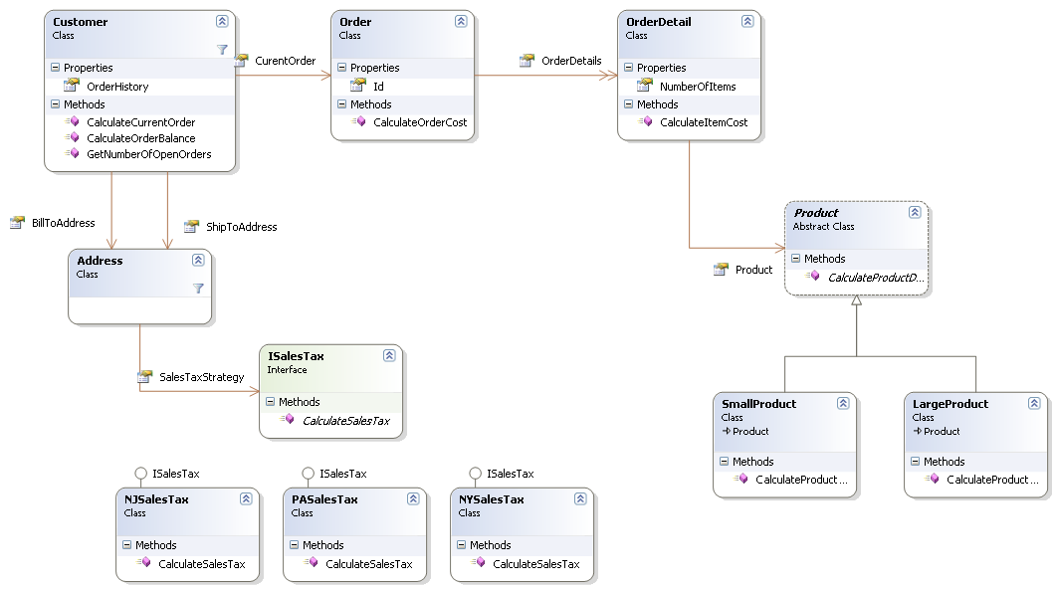
Domain Model – (The Heart of the System)

Slide 18
Repository Pattern
Data
Model
Repository
XML
Cache
Mapper(s)

Slide 19
Service Layer Pattern
yer
Service
Product Controller
Business API
Model
Persist Ignorance
Repository
Layer

Slide 20
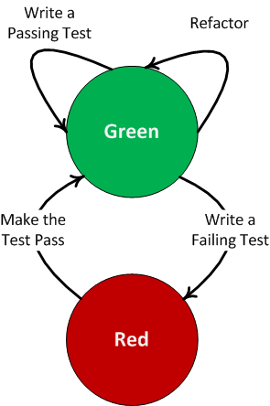
TDD & Refactoring
Test Driven Development
Focuses on design and code quality
Tests drive class design (Iterative approach)
Not a replacement for functionality testing
Use Mocking to test classes in isolation
Refactoring
Process of improving the design of existing code
Focus on making small changes
Tests help drive the process
Code Smells
Source: http://www.agileprogrammer.com/uploads/bradwils/red_2Dgreen_2Drefactor.png

Slide 21
Q & A (thanks!)
Todd Snyder
Email: tsnyder@infragistics.com
Blog: http://blogs.infragistics.com/blogs/tsnyder

Slide 22
Resources
Todd Snyder
tsnyder@infragistics.com
http://blogs.infragistics.com/blogs/tsnyder
Books
Agile Principles, Patterns, and Practices in C#
Patterns of Enterprise Application Architecture
Refactoring to Patterns
Refactoring: Improving the design of existing code
Domain-Driven Design: Tackling Complexity in the Heart of Software
Web Sites
Enterprise Patterns defined by Martin Fowler
GOF Patterns in C#
Object Oriented Analysis and Design
MVP Pattern in C#
Value of using the MVP Pattern

